Slide 1
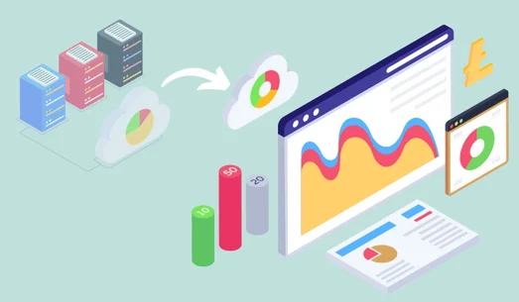
DATA
INSIGHTS

Slide 2

Addressing the Problem Statement
Provided Dataset Contains:
1: Sales 2:Products 3:Stores 4:Customers 5:Currency Exchange Rate
Data Provider:
Global Electronics is a customer focused Trader and Authorized distributor of Electronic Components & System with headquarters in Pune established in the year 2007, the company seeks to leverage this data to better understand their business and identify areas for improvement.
Goal:
Job is to conduct a comprehensive Exploratory Data Analysis
(EDA) to uncover valuable insights from the company’s data. Aim is to
identify key insights that will enhance
1: Marketing strategies 2: Optimize inventory management
3: Improve sales forecasting 4: Develop better products
5: Plan effective promotions,

Slide 3
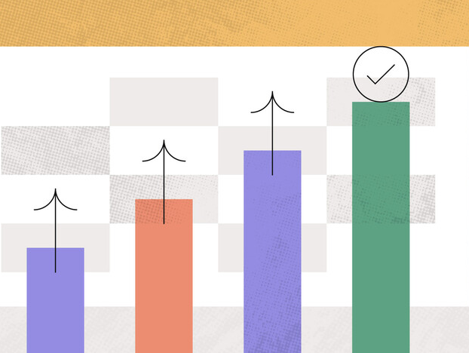
Sales Quantity and Profit trend over the years recorded on Data
Technique Used:
GROUP BY: Groups the data by a specific column (year in this case). ORDER BY: Orders the results by a specified column..
Results:
In 2020, sales and profit were 50% lower compared to 2019. This decline is slightly above the average annual sales, so it’s not an alarming drop, but it does require attention.
Discussion:
In 2020 the performance is dropped huge level , need to spot the reason of drop, whether its because of 1:Customers dissatisfaction 2:Product failure 3:Lack/Failure of promotion strategies

Slide 4

Monthly trends in quantity sold and profit over the recorded years
Technique Used:
GROUP BY: Groups the data by a specific column (year in this case). ORDER BY: Orders the results by a specified column..
Results:
Peak sales occur from December to February, so we can avoid markdowns, stock up on inventory, which reduce customer waiting period.
Discussion:
We need to identify the cause of the sales drop, 1:Any Seasonal/Cultural Celebrations 2:External factors like Economic Conditions 3:Competitor Actions

Slide 5

2021 vs others: January and February Sales Quantities Analysis for Performance Prediction
Technique Used:
WHERE Clause: Filters the data to include only January and February. GROUP BY: Groups the data by a specific column (year in this case). ORDER BY: Orders the results by a specified column.
Results:
In 2021, sales for January and February are lower than both the best (2019) and worst (2016) years, signaling a need for urgent business growth attention.
Discussion:
We need to identify the cause of the sales drop, 1:Economic Downturn 2:Seasonal Effects 3:Pandemic Impact 4:Supply Chain Issue

Slide 6

Demographic Customers Breakdown by their Age Group
Technique Used:
CASE: Is a type of expression used in SQL to create conditional logic.(age group in this case) GROUP BY: Groups the data by a specific column (age group in this case). ORDER BY: Orders the results by a specified column.
Results:
We discovered that 30% of our customers are aged 70 and above, while only 10% are in the 20-29 age group. To secure long-term growth, we should adjust our promotion strategy to better better attract and engage the younger generation.
Discussion:
We need to to take some specific actions like 1:Targeted Market Campaigns (with target as younger demographics) 2:Digital Engagement (since younger gen prefers tech) 3:Loyalty Programs 4:Influencer Marketing(with strong following among younger demographics)

Slide 7
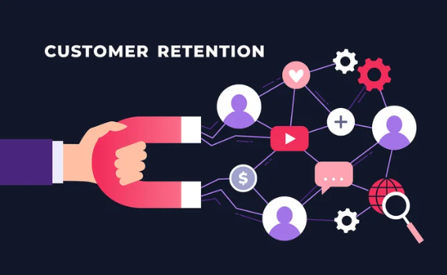
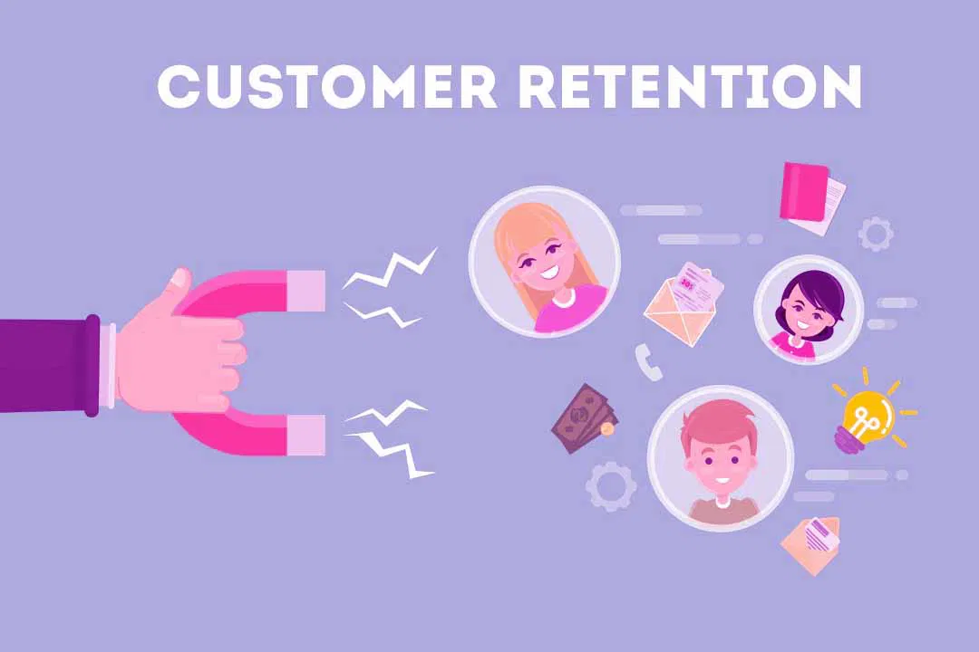

Customers with No Purchase Activity
Technique Used:
LEFT JOIN: Returns all records from the left table and matched records from the right table, with NULLs for non-matching rows. WHERE: Filters records based on specified conditions. IS NULL: Checks for NULL values in a column
Results:
We identified 3,379 inactive customers, mostly from the USA and Australia, suggesting dissatisfaction or loyalty to competitors. This represents one-fourth of our customer base and needs immediate attention needs immediate attention.
Discussion:
We need to to take some specific actions like 1:Re-engagement Campaigns 2:Competitor Analysis 3:Geographic Focus 4:Personalized Communication

Slide 8

Sales Spectrum: Color Performance
Technique Used:
JOIN : In SQL it combines rows from two or more tables based on a related column. GROUP BY: Groups the data by a specific column (color in this case). ORDER BY: Orders the results by a specified column.
Results:
Top-selling products are black, followed by grey and white, indicating customers may be unaware of other color options or prefer neutral tones. This insight helps us manage inventory and promotions for paint and color-based products more effectively.
Discussion:
We need to to take some specific actions like 1:Inventory Management(Increase stock of popular color products) 2:Customer Awareness(about variety of color options available) 3:Product Development(new shades or variations of popular colors)

Slide 9

Stores Without Corresponding Sales Records
Technique Used:
LEFT JOIN: Returns all records from the left table and matched records from the right table, with NULLs for non-matching rows. WHERE: Filters records based on specified conditions. IS NULL: Checks for NULL values in a column
Results:
Some stores show zero sales during the given period, likely due to either data entry issues or closures. These stores, opened 4 to 10 years ago, complicate drawing fixed insights. Nonetheless, they still require attention.
Discussion:
We need to to take some specific actions like 1:Data Verification(about data entry issues) 2:Store Status Check(still operational or have been closed) 3:Historical Analysis( performance trends of these stores) 4:Strategic Focus( either revive stores or officially close them)

Slide 10
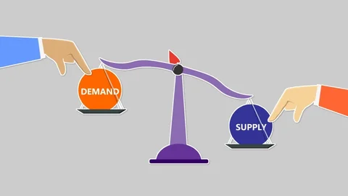
Leading Product Categories by Sales Volume
Technique Used:
JOIN : In SQL it combines rows from two or more tables based on a related column. GROUP BY: Groups the data by a specific column (category in this case). ORDER BY: Orders the results by a specified column.
Results:
We identified computers as the top-performing product category and TV and video as the least performing. This insight allows us to manage inventory more effectively by prioritizing stock for high-demand items.
Discussion:
We need to to take some specific actions like 1:Inventory Management(Increase for high demand decrease for least ) 2:Customer Feedback(understand the reasons for low performance) 3:Marketing and Promotions

Slide 11

Store Performance Analysis: Insights on Total Profit
Technique Used:
JOIN : In SQL it combines rows from two or more tables based on a related column. SUBQUERY: Is an nested query within a larger query that provides intermediate results used by the main query. GROUP BY: Groups the data by a specific column (storekey in this case).
Results:
The performance gap between the least and average-performing stores is significant. Store 2 in Australia requires particular attention to either improve its performance or consider closure, as Australia also ranks lowest in country-wise performance.
Discussion:
We need to to take some specific actions like 1:Performance Review(for store 2) 2:Resource Allocation(staff training, marketing budget, inventory planning) 3:Market Analysis(in australia) 4:Exit Strategy(if no improvement)

Slide 12

Analyzing Average Profits in USD Across Various Currencies
Technique Used:
WHERE: filter records based on specific conditions. GROUP BY: Groups the data by a specific column (category in this case). ORDER BY: Orders the results by a specified column.
Results:
The chart and correlation analysis indicate that exchange rates may have some influence on profits, but their impact appears to be minimal in this dataset. This suggests that other factors are likely playing a more significant role in determining profits.
Discussion:
We need to to take some specific actions like 1:Diversify Revenue Streams 2:Identify Key Factors 3:Monitor Regularly

